Slide 1
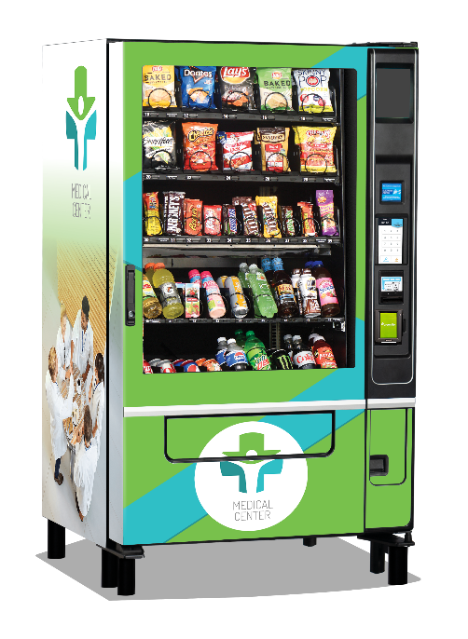
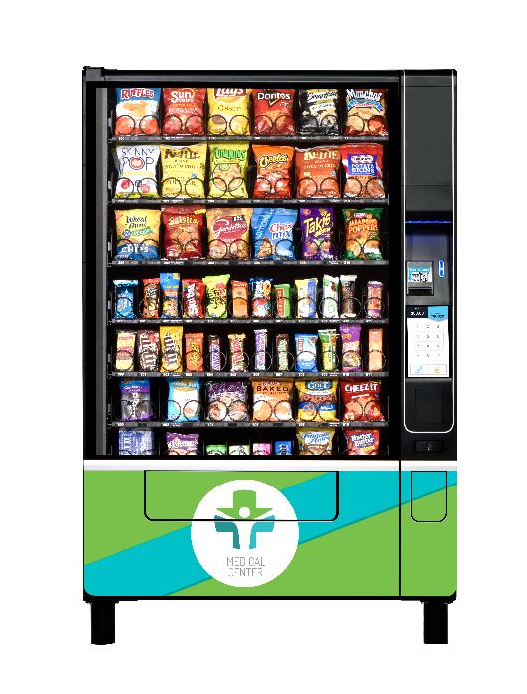
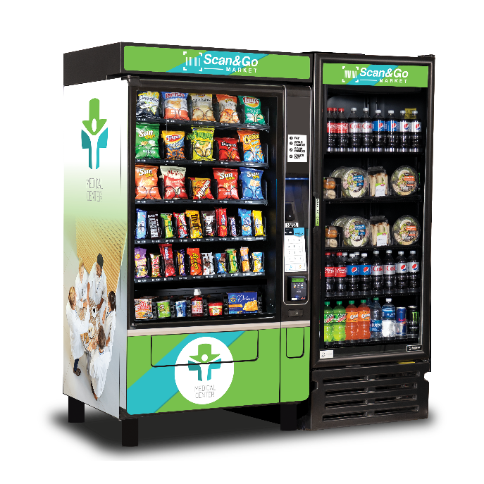
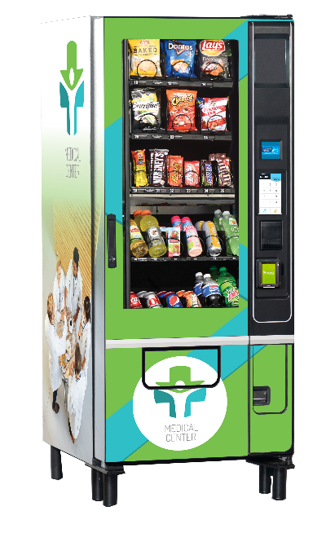
Experience the best in vending
EVOKE SERIES MERCHANDISERS
WIDEST RANGE IN THE INDUSTRY
Standard ADA Compliant
Guaranteed product delivery
Largest merchandising window
Most Intuitive controller w/ open API’s
Largest delivery bins
High output LED lighting
Backlit keypad & touchscreens
Snack, Refrigerated, Frozen, Hot/Cold Beverage

Slide 2


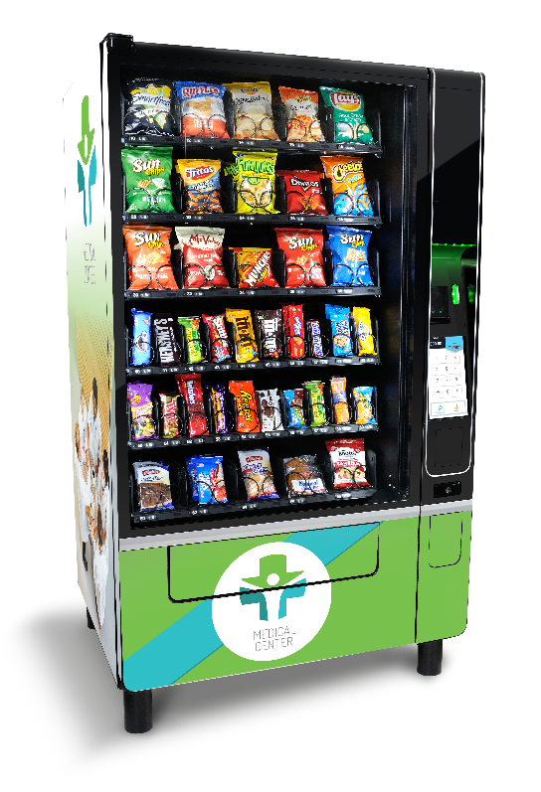


Slide 3

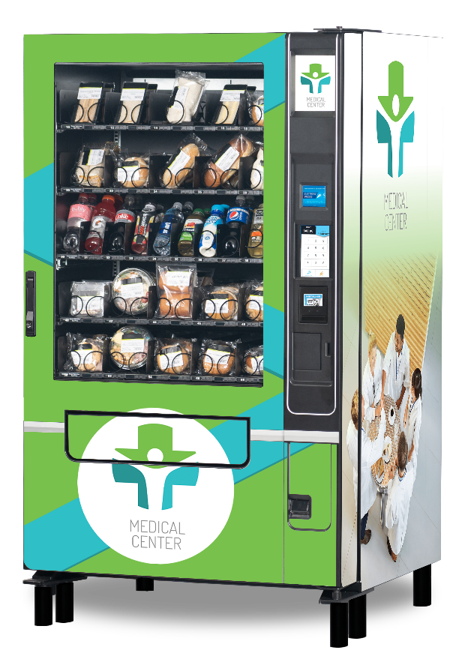


Slide 4


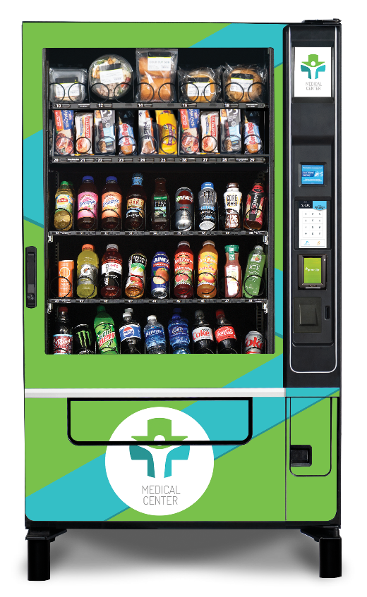


Slide 5

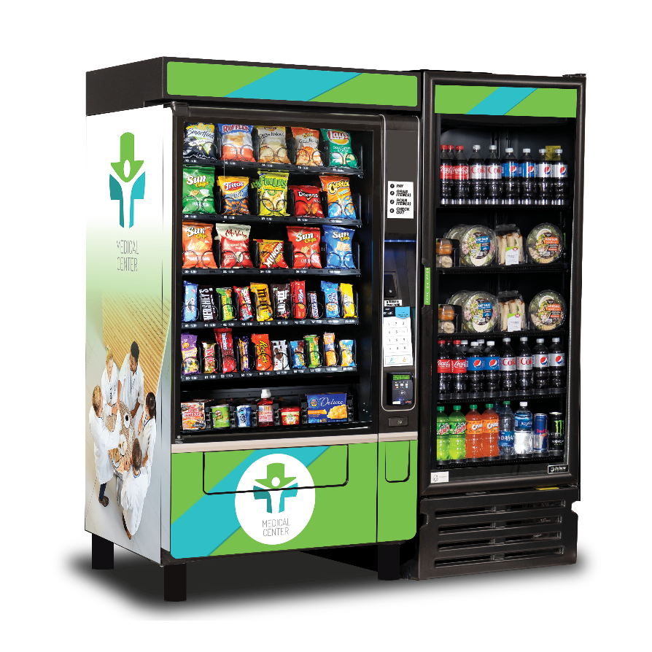

Slide 6
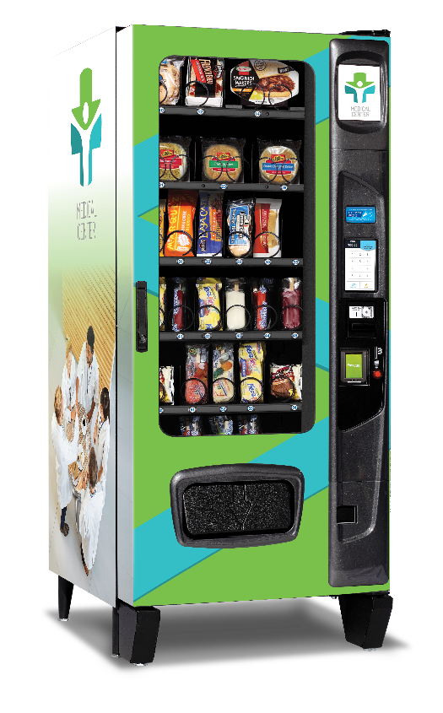
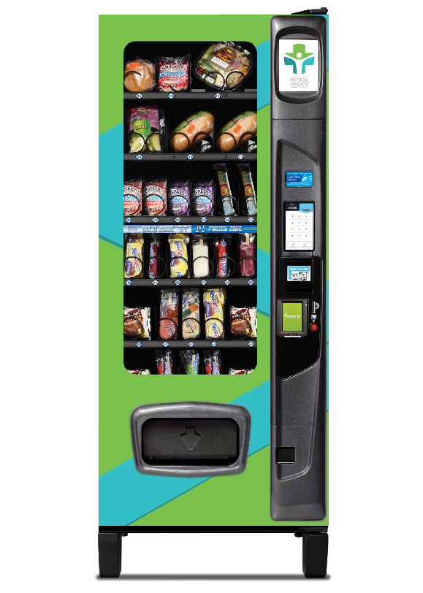
Combi 3000 Frozen

